Slide 2
Quan tam
1>System database
2>Option type
3> Filegroups
4>Transaction log
5>create ,drop database
6>database procedure
7>Types of Database Modification Methods

Slide 3
Objectives
Describe system and user-defined databases
List the key features of the AdventureWorks2012 sample database
Describe adding of filegroups and transaction logs
Describe the procedure to create a database
List and describe types of database modifications
Describe the procedure to drop a database
Describe database snapshots

Slide 4
Introduction 1-3
A database is a collection of data stored in data files on a disk or some removable medium.
A database consists of data files to hold actual data.
An SQL Server database is made up of a collection of tables that stores sets of specific structured data.
A table includes a set of rows (also called as records or tuples) and columns (also called as attributes).
Each column in the table is intended to store a specific type of information, for example, dates, names, currency amounts, and numbers.
A user can install multiple instances of SQL Server on a computer.
Each instance of SQL Server can include multiple databases.
Within a database, there are various object ownership groups called schemas.

Slide 5
Introduction 2-3
Within each schema, there are database objects such as tables, views, and stored procedures.
Some objects such as certificates and asymmetric keys are contained within the database, but are not contained within a schema.
SQL Server databases are stored as files in the file system.
These files are grouped into file groups.
When people gain access to an instance of SQL Server, they are identified as a login.
When people gain access to a database, they are identified as a database user.
A user who has access to a database can be given permission to access the objects in the database.

Slide 6
Introduction 3-3
Though permissions can be granted to individual users, it is recommended to create database roles, add the database users to the roles, and then, grant access permission to the roles.
Granting permissions to roles instead of users makes it easier to keep permissions consistent and understandable as the number of users grow and continually change.
SQL Server 2012 supports three kinds of databases, which are as follows:
System Databases
User-defined Databases
Sample Databases

Slide 7
System Databases
SQL Server uses system databases to support different parts of the DBMS.
Each database has a specific role and stores job information that requires to be carried out by SQL Server.
The system databases store data in tables, which contain the views, stored procedures, and other database objects.
They also have associated database files (for example, .mdf and .ldf files) that are physically located on the SQL Server machine.
Following table shows the system databases that are supported by SQL Server 2012:
^{Database} | ^{Description}
master | The database records all system-level information of an instance of SQL Server.
msdb | The database is used by SQL Server Agent for scheduling database alerts and various jobs.
model | The database is used as the template for all databases to be created on the particular instance of SQL Server 2012.
resource | The database is a read-only database. It contains system objects included with SQL Server 2012.
tempdb | The database holds temporary objects or intermediate result sets.

Slide 8
Modifying System Data 1-3
Users are not allowed to directly update the information in system database objects, such as system tables, system stored procedures, and catalog views.
However, users can avail a complete set of administrative tools allowing them to fully administer the system and manage all users and database objects.
These are as follows:
Administration Utilities:
From SQL Server 2005 onwards, several SQL Server administrative utilities are integrated into SSMS.
It is the core administrative console for SQL Server installations.
It enables to perform high-level administrative functions, schedule routine maintenance tasks, and so forth.

Slide 9
Modifying System Data 2-3
Following figure shows the SQL Server 2012 Management Studio window:
SQL Server Management Objects (SQL-SMO) API:
Includes complete functionality for administering SQL Server in applications.

Slide 10
Modifying System Data 3-3
Transact-SQL scripts and stored procedures:
These use system stored procedures and Transact-SQL DDL statements. Following figure shows a Transact-SQL query window:

Slide 11
Viewing System Database Data
Database applications can determine catalog and system information by using any of these approaches:
System catalog views
Views displaying metadata for describing database objects in an SQL Server instance.
SQL-SMO
New managed code object model, providing a set of objects used for managing Microsoft SQL Server.
Catalog functions, methods, attributes, or properties of the data API
Stored Procedures and Functions
Used in ActiveX Data Objects (ADO), OLE DB, or ODBC applications.
Used in Transact-SQL as stored procedures and built-in functions.

Slide 12
Creating Databases 1-4
To create a user-defined database, the information required is as follows:
Name of the database
Owner or creator of the database
Size of the database
Files and filegroups used to store it

Slide 13
Creating Databases 2-4
The syntax to create a user-defined database is as follows:
Syntax:
CREATE DATABASE DATABASE_NAME
[ ON
[ PRIMARY ] [ <filespec> [ ,...n ]
[ , <filegroup> [ ,...n ] ]
[ LOG ON { <filespec> [ ,...n ] } ]
]
[ COLLATE collation_name ]
]
[;]
where,
DATABASE_NAME: is the name of the database to be created.
ON: indicates the disk files to be used to store the data sections of the database and data files.
PRIMARY: is the associated <filespec> list defining the primary file.
<filespec>: controls the file properties.
<filegroup>: controls filegroup properties.

Slide 14
Creating Databases 3-4
LOG ON: indicates disk files to be used for storing the database log and log files.
COLLATE collation_name: is the default collation for the database. A collation defines rules for comparing and sorting character data based on the standard of particular language and locale. Collation name can be either a Windows collation name or a SQL collation name.
Following code snippet shows how to create a database with database file and transaction log file with collation name:
CREATE DATABASE [Customer_DB] ON PRIMARY
( NAME = 'Customer_DB', FILENAME = 'C:\Program Files\Microsoft SQL Server\MSSQL11.MSSQLSERVER\MSSQL\DATA\Customer_DB.mdf')
LOG ON
( NAME = 'Customer_DB_log', FILENAME = 'C:\Program Files\Microsoft SQL Server\MSSQL11.MSSQLSERVER\MSSQL\DATA\Customer_DB_log.ldf')
COLLATE SQL_Latin1_General_CP1_CI_AS
After executing the code, SQL Server 2012 displays the message 'Command(s) completed successfully‘.

Slide 15
Creating Databases 4-4
Following figure shows the database Customer_DB listed in the Object Explorer:

Slide 16
Modifying Databases 1-3
As a user-defined database grows or diminishes, the database size will be expanded or be shrunk automatically or manually.
The syntax to modify a database is as follows:
Syntax:
ALTER DATABASE database_name
{
<add_or_modify_files>
| <add_or_modify_filegroups>
| <set_database_options>
| MODIFY NAME = new_database_name
| COLLATE collation_name
}
[;]
where,
database_name: is the original name of the database.
MODIFY NAME = new_database_name: is the new name of the database to which it is to be renamed.
COLLATE collation_name: is the collation name of the database.

Slide 17
Modifying Databases 2-3
<add_or_modify_files>: is the file to be added, removed, or modified.
<add_or_modify_filegroups>: is the filegroup to be added, modified, or removed from the database.
<set_database_options>: is the database-level option influencing the characteristics of the database that can be set for each database. These options are unique to each database and do not affect other databases.
Following code snippet shows how to rename a database Customer_DB with a new database name, CUST_DB:
ALTER DATABASE Customer_DB MODIFY NAME = CUST_DB

Slide 18
Modifying Databases 3-3
Following figure shows database Customer_DB is renamed with a new database name, CUST_DB:

Slide 19
Ownership of Databases 1-2
In SQL Server 2012, the ownership of a user-defined database can be changed.
Ownership of system databases cannot be changed.
The system procedure sp_changedbowner is used to change the ownership of a database. The syntax is as follows:
Syntax:
sp_changedbowner [ @loginame = ] 'login‘
where,
login: is an existing database username.

Slide 20
Ownership of Databases 2-2
After sp_changedbowner is executed, the new owner is known as the dbo user inside the selected database.
The dbo receives permissions to perform all activities in the database.
The owner of the master, model, or tempdb system databases cannot be changed.
Following code snippet, when executed, makes the login 'sa' the owner of the current database and maps 'sa' to existing aliases that are assigned to the old database owner, and will display 'Command(s) completed successfully‘:
USE CUST_DB
EXEC sp_changedbowner 'sa’

Slide 21
Setting Database Options 1-2
Database-level options determine the characteristics of the database that can be set for each database.
These options are unique to each database, so they do not affect other databases.
These database options are set to default values when a database is first created, and can then, be changed by using the SET clause of the ALTER DATABASE statement.
Following table shows the database options that are supported by SQL Server 2012:
^{Option Type} | ^{Description}
Automatic options | Controls automatic behavior of database.
Cursor options | Controls cursor behavior.
Recovery options | Controls recovery models of database.
Miscellaneous options | Controls ANSI compliance.
State options | Controls state of database, such as online/offline and user connectivity.

Slide 22
Setting Database Options 2-2
Following code snippet when executed sets AUTO_SHRINK option for the CUST_DB database to ON:
USE CUST_DB;
ALTER DATABASE CUST_DB
SET AUTO_SHRINK ON
The AUTO_SHRINK options when set to ON, shrinks the database that have free space.

Slide 23
AdventureWorks2012 Database 1-2
The AdventureWorks2012 database consists of around 100 features.
Some of the key features are as follows:
Database Engine
Analysis Services
Integration Services
Notification Services
Replication Facilities
Reporting Services
A set of integrated samples for two multiple feature-based samples: HRResume and Storefront.

Slide 24
AdventureWorks2012 Database 2-2
The sample database consists of these parts:
AdventureWorks2012: Sample OLTP database
AdventureWorks2012DW: Sample Data warehouse
AdventureWorks2012AS: Sample Analysis Services database

Slide 25
Filegroups 1-2
In SQL Server, data files are used to store database files. The data files are further subdivided into filegroups for the sake of performance.
Each filegroup is used to group related files that together store a database object.
Every database has a primary filegroup by default. This filegroup contains the primary data file.
The primary file group and data files are created automatically with default property values at the time of creation of the database.
User-defined filegroups can then be created to group data files together for administrative, data allocation, and placement purposes.
Notes:
Sake: lợi ích

Slide 26
Filegroups 2-2
For example, three files named Customer_Data1.ndf, Customer_Data2.ndf, and Customer_Data3.ndf can be created on three disk drives respectively.
These can then be assigned to the filegroup Customer_fgroup1. A table can then be created specifically on the filegroup Customer_fgroup1.
Queries for data from the table will be spread across the three disk drives thereby, improving performance.
Following table shows the filegroups that are supported by SQL Server 2012:
^{Filegroup} | ^{Description}
Primary | The filegroup that consists of the primary file. All system tables are placed inside the primary filegroup.
User-defined | Any filegroup that is created by the user at the time of creating or modifying databases.

Slide 27
Adding Filegroups to an Existing Database 1-5
Filegroups can be created when the database is created for the first time or can be created later when more files are added to the database.
However, files cannot be moved to a different filegroup after the files have been added to the database.
A file cannot be a member of more than one filegroup at the same time.
Filegroups can contain only data files. Transaction log files cannot belong to a filegroup.
A maximum of 32,767 filegroups can be created for each database.

Slide 28
Adding Filegroups to an Existing Database 2-5
The following is the syntax to add filegroups while creating a database:
Syntax:
CREATE DATABASE database_name
[ ON
[ PRIMARY ] [ <filespec> [ ,...n ]
[ , <filegroup> [ ,...n ] ]
[ LOG ON { <filespec> [ ,...n ] } ]
]
[ COLLATE collation_name ]
]
[;]
where,
database_name: is the name of the new database.
ON: indicates the disk files to store the data sections of the database, and data files.
PRIMARY and associated <filespec> list: define the primary file. The first file specified in the <filespec> entry in the primary filegroup becomes the primary file.
LOG ON: indicates the disk files used to store the database log files.
COLLATE collation_name: is the default collation for the database.

Slide 29
Adding Filegroups to an Existing Database 3-5
Following code snippet shows how to add a filegroup (PRIMARY as default) while creating a database, called SalesDB:
CREATE DATABASE [SalesDB] ON PRIMARY
( NAME = 'SalesDB', FILENAME ='C:\Program Files\Microsoft SQL
Server\MSSQL11.MSSQLSERVER\MSSQL\DATA\SalesDB.mdf' , SIZE = 3072KB ,
MAXSIZE = UNLIMITED, FILEGROWTH = 1024KB ),
FILEGROUP [MyFileGroup]
( NAME = 'SalesDB_FG', FILENAME = 'C:\Program Files\Microsoft SQL
Server\MSSQL11.MSSQLSERVER\MSSQL\DATA\SalesDB_FG.ndf' , SIZE = 3072KB ,
MAXSIZE = UNLIMITED, FILEGROWTH = 1024KB )
LOG ON
( NAME = 'SalesDB_log', FILENAME = 'C:\Program Files\Microsoft SQL
Server\MSSQL11.MSSQLSERVER\MSSQL\DATA\SalesDB_log.ldf' , SIZE = 2048KB ,
MAXSIZE = 2048GB , FILEGROWTH = 10%)
COLLATE SQL_Latin1_General_CP1_CI_AS

Slide 30
Adding Filegroups to an Existing Database 4-5
Following figure shows the file groups when creating SalesDB database:

Slide 31
Adding Filegroups to an Existing Database 5-5
The syntax to add a filegroup to an existing database is as follows:
ALTER DATABASE database_name
{ <add_or_modify_files>
| <add_or_modify_filegroups>
| <set_database_options>
| MODIFY NAME = new_database_name
| COLLATE collation_name
}
[;]
Following code snippet shows how to add a filegroup to an existing database, called CUST_DB:
USE CUST_DB;
ALTER DATABASE CUST_DB
ADD FILEGROUP FG_ReadOnly0
After executing the code, SQL Server 2012 displays the message 'Command(s) completed successfully' and the filegroup FG_ReadOnly is added to the existing database, CUST_DB.

Slide 32
Default Filegroup 1-2
Objects are assigned to the default filegroup when they are created in the database.
The PRIMARY filegroup is the default filegroup. The default filegroup can be changed using the ALTER DATABASE statement.
System objects and tables remain within the PRIMARY filegroup, but do not go into the new default filegroup.
To make the FG_ReadOnly filegroup as default, it should contain at least one file inside it.
Following code snippet shows how to create a new file, add it to the FG_ReadOnly filegroup, and make the FG_ReadOnly filegroup as the default filegroup:
USE CUST_DB
ALTER DATABASE CUST_DB
ADD FILE (NAME = Cust_DB1, FILENAME = 'C:\Program Files\Microsoft SQL Server\MSSQL11.MSSQLSERVER\MSSQL\DATA\Cust_DB1.ndf')
TO FILEGROUP FG_ReadOnly
ALTER DATABASE CUST_DB
MODIFY FILEGROUP FG_ReadOnly DEFAULT
After executing the code, SQL Server 2012 displays the message saying the filegroup property 'DEFAULT' has been set.

Slide 33
Default Filegroup 2-2
Following figure shows a new file Cust_DB1 created:

Slide 34
Transaction Log 1-4
A transaction log in SQL Server records all transactions and the database modifications made by each transaction.
The transaction log is one of the critical components of the database.
It can be the only source of recent data in case of system failure.
The transaction logs support operations such as the following:
Recovery of individual transactions
An incomplete transaction is rolled back in case of an application issuing a ROLLBACK statement or the Database Engine detecting an error.
Recovery of all incomplete transactions when SQL Server is started
If a server that is running SQL Server fails, the databases may be left in an inconsistent state.
The log records are used to roll back the modifications.
When an instance of SQL Server is started, it runs a recovery of each database.

Slide 35
Transaction Log 2-4
Rolling a restored database, file, filegroup, or page forward to the point of failure
The database can be restored to the point of failure after a hardware loss or disk failure affecting the database files.
Supporting transactional replication
The Log Reader Agent monitors the transaction log of each database configured for replications of transactions.
Supporting standby server solutions
The standby-server solutions, database mirroring, and log shipping depend on the transaction log.

Slide 36
Transaction Log 3-4
Working of Transaction Logs:
A database in SQL Server 2012 has at least one data file and one transaction log file.
Data and transaction log information are kept separated on the same file.
Individual files are used by only one database.
The transaction log is a serial record of all modifications that have occurred in the database as well as the transactions that performed the modifications.
SQL Server uses the transaction log of each database to recover transactions.
This log keeps enough information to undo the modifications made during each transaction.
The transaction log records the allocation and deallocation of pages and the commit or rollback of each transaction.
This feature enables SQL Server either to roll forward or to back out.

Slide 37
Transaction Log 4-4
The rollback of each transaction is executed using the following ways:
A transaction is rolled forward when a transaction log is applied.
A transaction is rolled back when an incomplete transaction is backed out.
Adding Log files to a database:
The syntax to modify a database and add log files is as follows:
Syntax:
ALTER DATABASE database_name
{
...
}
[;]
<add_or_modify_files>::=
{
ADD FILE <filespec> [ ,...n ]
[ TO FILEGROUP { filegroup_name | DEFAULT } ]
| ADD LOG FILE <filespec> [ ,...n ]
| REMOVE FILE logical_file_name
| MODIFY FILE <filespec>
}

Slide 38
Create Database Procedure 1-7
The steps to create a database using SSMS are as follows:
1
In Object Explorer, connect to an instance of the SQL Server Database Engine and then, expand that instance.
2
Right-click Databases, and then, click New Database as shown in the following figure:

Slide 39
Create Database Procedure 2-7
3
In New Database, enter a database name.
4
To create the database by accepting all default values, click OK, as shown in the following figure; otherwise, continue with the following optional steps:

Slide 40
Create Database Procedure 3-7
5
To change the owner name, click (…) to select another owner.
6
To change the default values of the primary data and transaction log files, in the Database files grid, click the appropriate cell and enter the new value.
7
To change the collation of the database, select the Options page, and then, select a collation from the list.

Slide 41
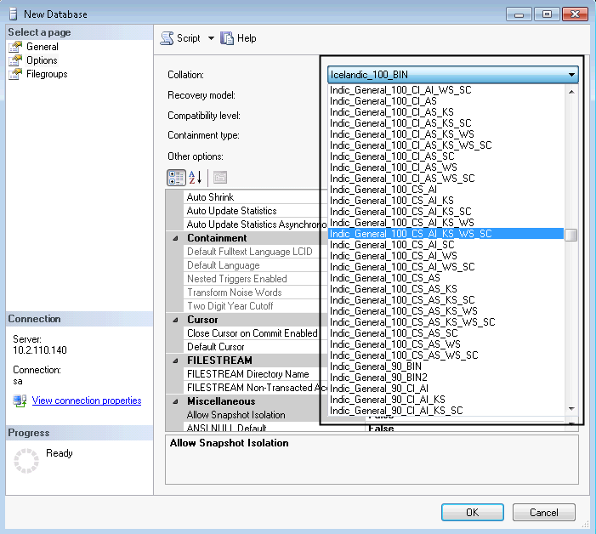
Create Database Procedure 4-7
This is shown in the following figure:

Slide 42
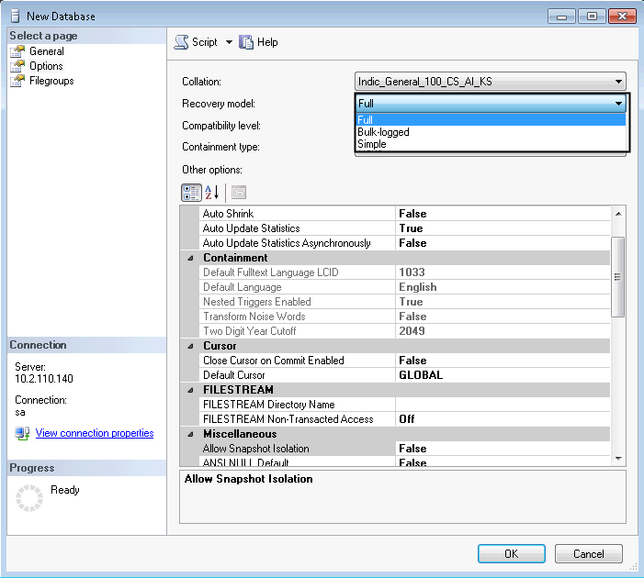
Create Database Procedure 5-7
8
To change the recovery model, select the Options page and then, select a recovery model from the list as shown in the following figure:

Slide 43
Create Database Procedure 6-7
9
To change database options, select the Options page, and then, modify the database options.
10
To add a new filegroup, click the Filegroups page. Click Add and then, enter the values for the filegroup as shown in the following figure:

Slide 44
Create Database Procedure 7-7
11
To add an extended property to the database, select the Extended Properties page.
12
To create the database, click OK.
In the Name column, enter a name for the extended property.
In the Value column, enter the extended property text. For example, enter one or more statements that describe the database.

Slide 45
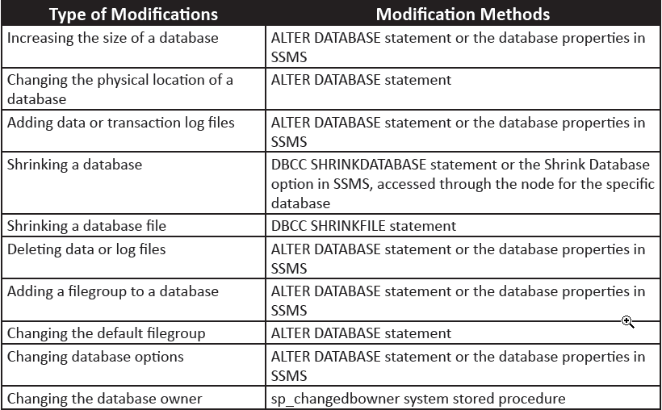
Types of Database Modification Methods
Following table lists and describes types of modifications of databases and modification methods:

Slide 46
Drop Database Procedure 1-4
A full backup of the database needs to be taken before dropping a database.
A deleted database can be re-created only by restoring a backup.
The steps to delete or drop a database using SSMS are as follows:
1
In Object Explorer, connect to an instance of the SQL Server Database Engine, and then, expand that instance.
2
Expand Databases, right-click the database to delete, and then, click Delete.

Slide 47
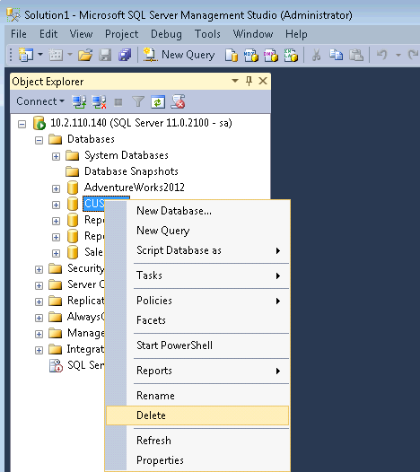
Drop Database Procedure 2-4
This is shown in the following figure:

Slide 48
Drop Database Procedure 3-4
3
Confirm that the correct database is selected, and then, click OK.
The syntax to delete or drop a database using Transact-SQL is as follows:
CREATE DATABASE database_snapshot_name
ON
(
NAME = logical_file_name,
FILENAME = 'os_file_name'
) [ ,...n ]
AS SNAPSHOT OF source_database_name
[;]
where,
database_snapshot_name: is the name of the new database snapshot.
ON ( NAME = logical_file_name, FILENAME = 'os_file_name' ) [ ,... n ]: is the list of files in the source database. For the snapshot to work, all the data files must be specified individually.

Slide 49
Drop Database Procedure 4-4
AS SNAPSHOT OF source_database_name: is the database being created is a database snapshot of the source database specified by source_database_name.
Following code snippet creates a database snapshot on the CUST_DB database:
CREATE DATABASE customer_snapshot01 ON
( NAME = Customer_DB, FILENAME = 'C:\Program Files\Microsoft SQL
Server\MSSQL11.MSSQLSERVER\MSSQL\DATA\Customerdat_0100.ss')
AS SNAPSHOT OF CUST_DB;

Slide 50
Summary
An SQL Server database is made up of a collection of tables that stores sets of specific structured data.
SQL Server 2012 supports three kinds of databases:
System databases
User-defined databases
Sample databases
SQL Server uses system databases to support different parts of the DBMS.
A fictitious company, Adventure Works Cycles is created as a scenario and the AdventureWorks2012 database is designed for this company.
The SQL Server data files are used to store database files, which are further subdivided into filegroups for the sake of performance.
Objects are assigned to the default filegroup when they are created in the database. The PRIMARY filegroup is the default filegroup.
A database snapshot is a read-only, static view of a SQL Server database.

